Slide 1
N8168P

Slide 2
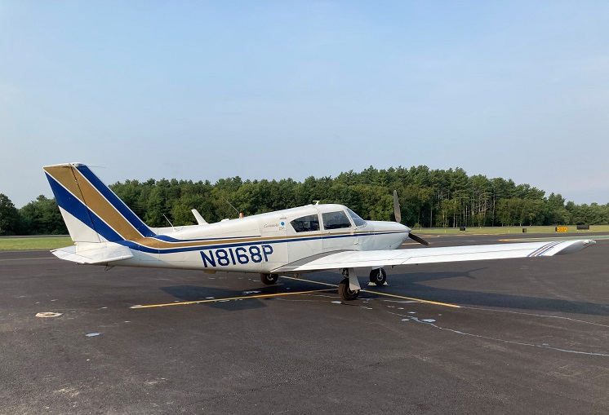
Comanche N8168P at Danielson

Slide 3
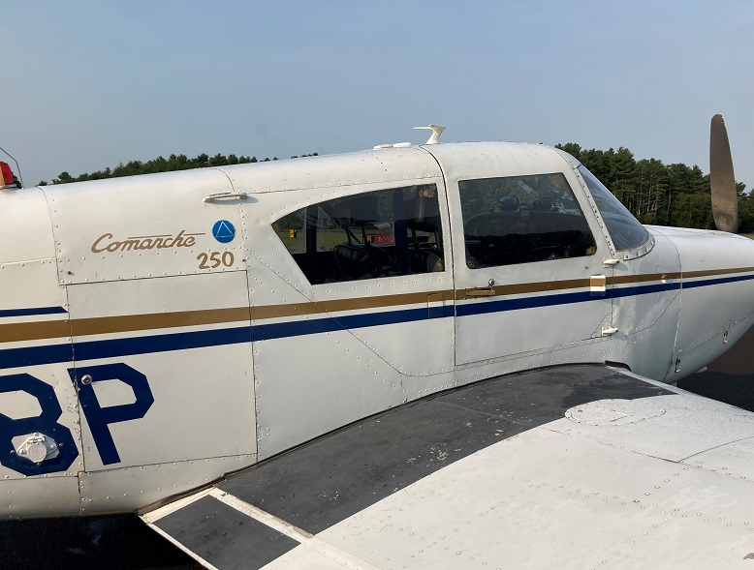
N8168P walkway

Slide 4
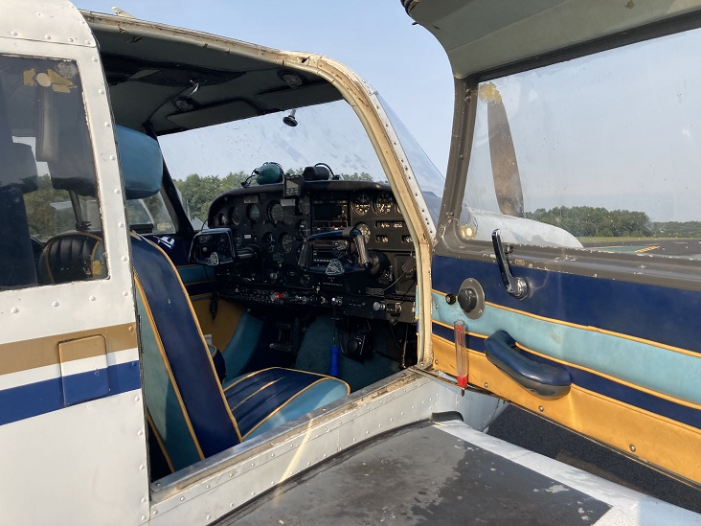
N8168P entry

Slide 5
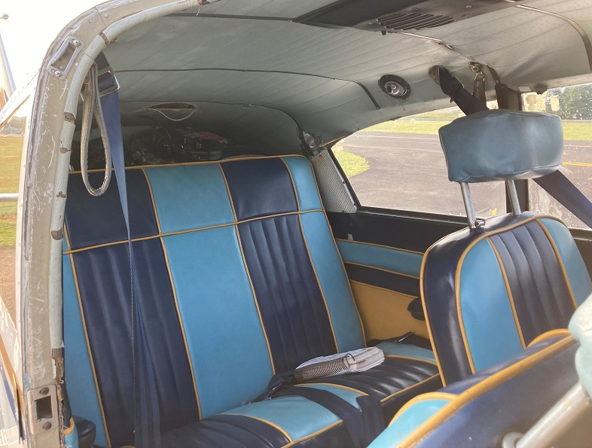
N8168P rear seat

Slide 6
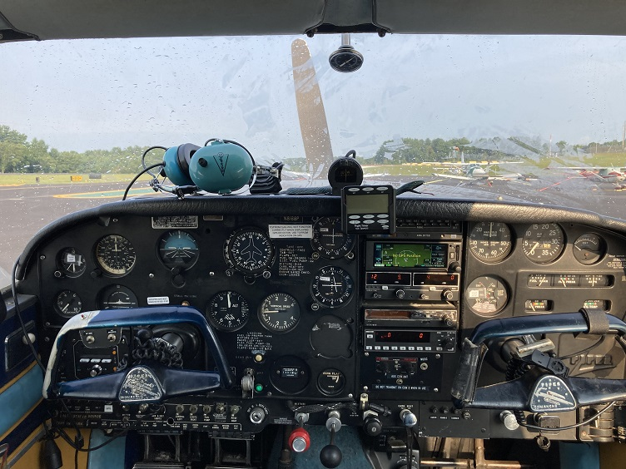
N8168P panel

Slide 7
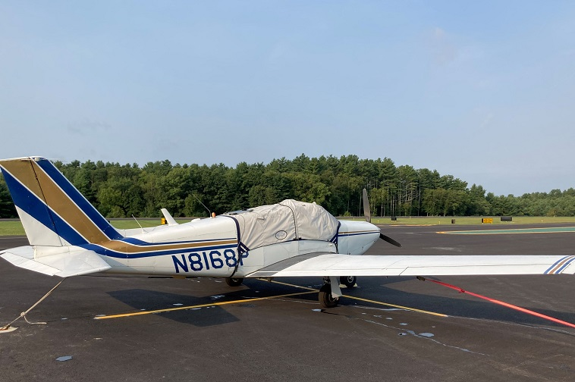
N8168P covered

Slide 8
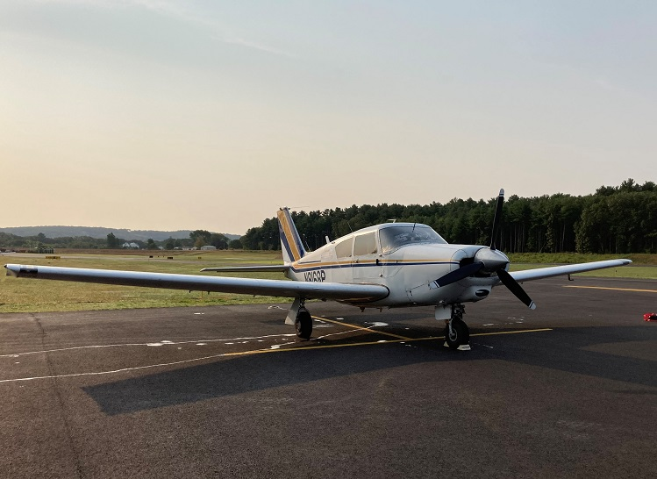
N8168P ready for flight

